Slide 1

A Basic Guide to
Using NexygenPlus 3
Materials Testing Software.
CLEAR VISION SOUND STRATEGIES SOLID PERFORMANCE
1

Slide 2

Introduction
Before continuing with this guide for using NexygenPlus software, please enure that you have read or have to hand, training modules TS1 and TS2. These cover basic overview of the installation and navigation of NexygenPlus 3.
The aim of this training guide is to provide simplified knowledge of and guidance for, the following features and operations:
  1. Creating a Test File (.batch file)
  2. Configuration of a simple Test Setup
  3. Overview of Results and Extra Measuring Points
  4. Test Option/Function Buttons
  5. Software Console Functionality
  6. Batch File Operations and Features
  7. Batch Report Designer
  8. Test Report & Export Functions

Slide 3
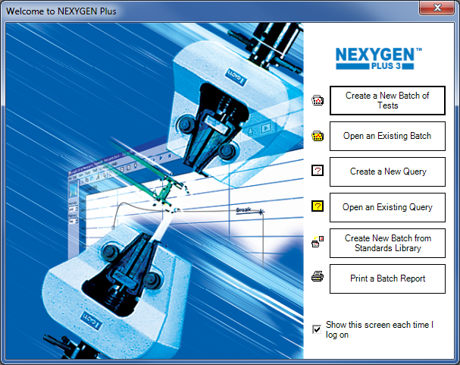
1. Creating a Test File (.batch file)
When the software is opened, the screen (by default) will show the ’Welcome To Nexygen Plus’
splash screen shown below:
A number of check boxes are displayed, one of which is ‘Create A New Batch of Tests’
Press this Button to start the creation of a new batch test file.
There is an option to hide this screen on start up.

Slide 4
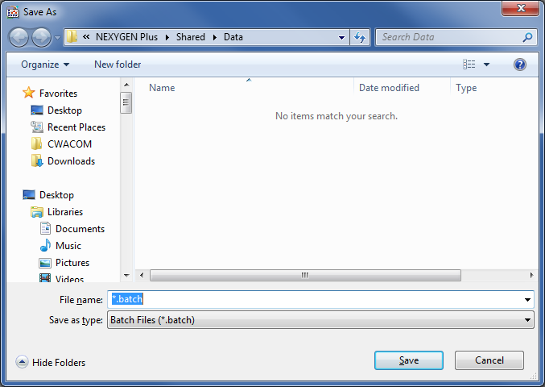
1. Creating a Test File (.batch file)
After the Create New Batch button is selected, the display will show a ’SAVE AS’ browse screen
pointing to the default ’DATA’ file path.
Note: Views may change dependent upon Operating System. Any existing batch files created and
saved will be shown in the list.
This screen allows the user to give the batch file being created a specific name. This is typed in the File Name box.
The File Type may not be changed and will always have the extension *.batch
Press the Save button to create the batch file in the selected file location.

Slide 5
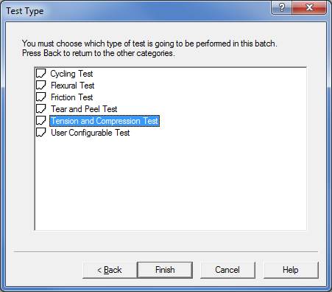
1. Creating a Test File (.batch file)
The TEST TYPE screen will display the six dedicated test method templates. To select a test type, use
the mouse button to highlight it.
Click ’Finish’ to create the file.

Slide 6
1. Creating a Test File (.batch file)
The Test Type method setups offered are:
  Tension or Compression Test
  Cycling Test
  Flexure Test
  Friction Test
  Tear and Peel Test
  User Configurable Test (User defined setup)
Note: This presentation will only cover the Tension or Compression Test setup.

Slide 7
1. Creating a Test File (.batch file)
The Tension or Compression Test is used for:
  Tension Test
  Pull to Break
  Pull To Limit
  Pull for a Time Duration
  Apply a Constant Load – Creep Test
  Measure Sample Relaxation
  Measure Rubber Modulus
  Measure Ring Stiffness

Slide 8
1. Creating a Test File (.batch file)
The Tension or Compression Test is used for:
  Compression Test
  Compress to Break
  Compress To Limit
  Compress for a Time Duration
  Apply a Constant Load – Creep Test
  Measure Sample Relaxation – Foam Test
  Measure Rubber Modulus
  Measure Ring Stiffness

Slide 9
1. Creating a Test File (.batch file)
Select the required Test Type: e.g Tension or Compression Test
Click on the FINISH button.
The software will now generate the required test file
The software will now display the TEST CONFIGURATION screen shown in section 2.

Slide 10
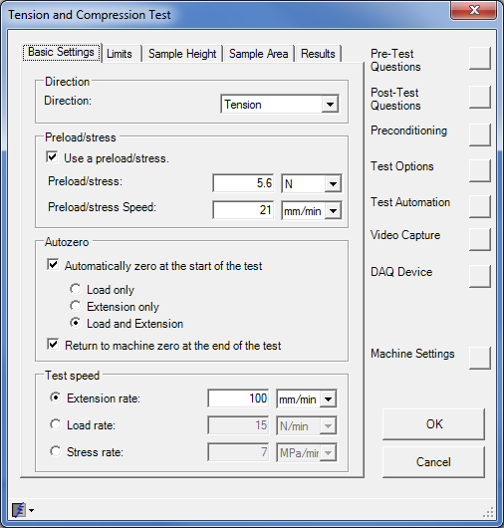
  2. Configuration of Test Setup
Basic Settings Tab
This is the first screen that will be shown when a
new batch file is created.
The header in the window shows the type of test
being configured, in this case :-
Tension and Compression Test.
The screen has 5 selectable tabs along the top and
8 option buttons down the right hand side.
The Basic Settings tab is used to define the main
test parameters:
Machine Direction
Machine Speed
Preload Options
Auto-Zero
Auto-Return

Slide 11
  2. Configuration of Test Setup
Basic Settings Tab
Preload Explanation:
In a Tension test when gripping a sample, there will always be settling of the grips on the sample
or small mechanical movement.
In a Compression test there will always be need to separate the grips or platens to allow placing of
sample.
In both cases where extension measurements are critical, the unwanted erroneous movement of the
machine to these points will be included in any extension or strain results.
To compensate for this a Preload setting is available. The Preload function automatically creates
a new graph axis labelled Extension From Preload and this axis is zeroed when the preload
force is applied to the sample. Other From Preload results are available once Preload is used.
Preload is also used when approaching a sample to measure it’s height using the datum height function.
The test uses this "Virtual Zero" for any extension movements and measurements BUT the Auto Return
feature returns the crosshead to the TRUE ZERO position.

Slide 12
  2. Configuration of Test Setup
Basic Settings Tab
Direction:
This tells the machine which direction to move in and the two options are:
Tension: Machine crosshead Moves UP
Compression: Machine crosshead Moves DOWN
Preload/Stress (optional): (Typical value is 0.5% to 5% of load cell size)
Preload is used to remove any unwanted crosshead movement when approaching the sample or
residual movement in the load train prior to testing of a sample. The two settings are:
Preload/stress: Load or Stress to be reached.
(N, lbf, kgf, N/mm², lbf/in², Mpa, etc...)
Preload/stress Speed: Speed at which the machine will run to this preload/stress value.
(mm/min, in/min, m/s, in/h, etc...)

Slide 13
  2. Configuration of Test Setup
Basic Settings Tab
Autozero: (optional)
This tells the software which input channels to zero prior to the start of a test. It is used to define a
machine home position or to remove any unwanted extension or load readings from results when
setting the machine. There are three options:
Load Only: Zero load channel only.
Extension Only: Zero extension channel only.
Load and Extension: Zero both load and extension channels.
(Default Zero Option)
Return to Machine Zero: (optional)
At the end of a test the machine can be returned to the home position (0 mm). This assumes
that the machine zero point has been set prior to a test starting.
Note: The Zero Load Only or Extension Only options are used for advanced testing and is
recommended that the default zero option is used for normal tests.

Slide 14
  2. Configuration of Test Setup
Basic Settings Tab
Test Speed:
Rate or speed that the machine will travel at after preload stage (if used), until the end of test.
Extension Rate: A rate of movement change over a time period.
(Default Speed) (mm/min, in/min, m/s, in/h, etc...)
Load Rate: A method to control a constant load applied to the sample over a time period. Machine will compensate for a change in sample characteristics during test.
(N/min, kgf/s, lbf/hr, kN/hr, etc...)
Stress Rate: A method to control a constant stress applied to the sample over a time period. The stress rate (Load/Area) requires the cross sectional area to be defined in the Sample Area Tab shown later.
(MPa/min, N/mm².s, lbf/in².hr, kgf/cm².min, etc...)
Note: Extension Rate is the basic default setting for machine speed setting and should normally be used. The other two test speeds can be used if defined by a test method or referenced by a test standard such as ASTM or EN.

Slide 15
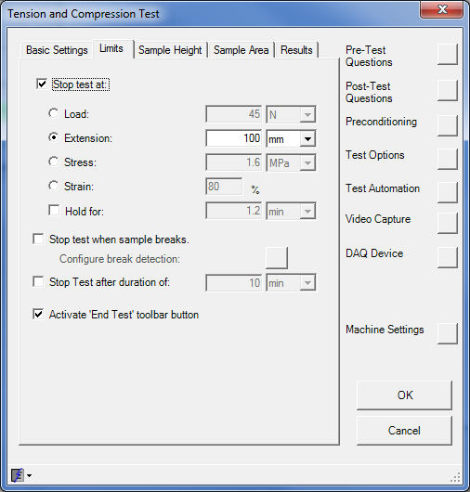

  2. Configuration of Test Setup
Limits Tab
Limits is the second tab option and this screen is
used to define the control limits of a test setup that
will terminate a test running:
Stop Test If Limit Reached, Hold Time,
Break Detection, Total Test Duration,
End Test Toolbar option
End Test Toolbar: (optional)
Enabling this option adds a black button to the
tool bar during the test (shown above). Pressing
this button causes the test to end at this point but
still run results if configured. This is useful for
example, if a sample is not going to reach the
target limit, but the results are still of interest.

Slide 16
  2. Configuration of Test Setup
Limits Tab
Stop Test At: (optional)
This option is enabled if a limit is required to stop the machine and test running. The test will stop when
this condition is met or exceeded.
Load: The load value that must be reached in order to stop the test.
Extension: The extension value that must be reached in order to stop the test.
Stress: The stress value that must be reached in order to stop the test. Based
upon on the Load/Area. Area must be defined in Sample Area Tab.
Strain: The percentage strain value that must be reached in order to stop the test. Based upon the orginal Height/Gauge Length. This must be defined in the Sample Height Tab.
Hold For: A time entry for which the test will be held for once the target limit entered has been reached.

Slide 17

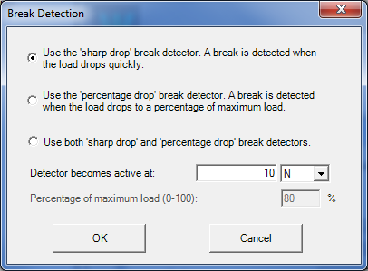
  2. Configuration of Test Setup
Limits Tab
Stop Test When Sample Breaks: (optional)
This is the Break Detection option and should be enabled if the sample is expected to break. At this
point the test, when a break is detected, will stop the machine running and calculate any results.
To enable the break detector function check the box marked ’Stop Test When Sample Breaks’ and then
press the square button to the right (circled) below to show the Break Detection configuration screen:
Sharp Drop: Use this option if the expected break occurs quickly.
Percentage Drop: Define a percentage of the current maximum load reading dropped to.
Use Both: This option can be used if the break
performance is unknown.
Detector Active: The minimum load the test must
reach before the detector is live.
Percentage Max Load: Enter percentage value of max load to drop to (i.e 80% of Max Load).

Slide 18
  2. Configuration of Test Setup
Limits Tab
Stop Test After Duration Of: (optional)
A finite test time can be entered that will end the test in a controlled manner, if the test limit conditions are
not met or the sample does not break.
This may be useful for long term fatigue testing, or if sample performance is unknown.
If a limit or break detection is configured and that point is reached, the test will stop at this time.

Slide 19
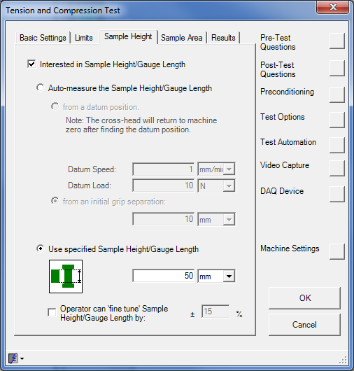
  2. Configuration of Test Setup
Sample Height Tab
Interested In Sample Height/Gauge Length: (optional)
Note: The test results can ONLY include Sample Height / Gauge Length related values,
e.g. Percentage Elongation or Strain, if the “Interested In Sample Height/Gauge Length” has been selected before running a test. This cannot be configured post test.
This screen is where the sample’s original Gauge Length or Height is entered. The software uses this value for determination of Strain and Percentage Elongation based results.
There are two options for entering the sample height information. One method is straight value entry that will be used in calculation of results. The other option contains two methods of corrected height measured using a datum function and preload.

Slide 20
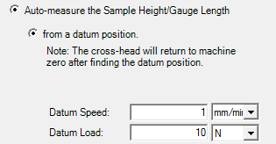

  2. Configuration of Test Setup
Sample Height Tab
Auto-measure the Sample Height / Gauge Length: (optional)
From a datum position: This option is an automatic measure of the sample height
(Compression Test) at the start of a test. It requires an initial driving of the compression plates together (without sample), to a
specified force. This must be used in conjunction with the
Preload option in Basic Settings. The Autozero option should be disabled. The sample height will be measured when the preload force is applied to the sample. Preload touch force and the approach speed for the faces to touch must be entered. The machine should be zeroed in a position such that the grips separation allows for a sample to be fitted. (The machine should not be zeroed again)
From an initial grip separation: This option requires the crosshead to be moved so that
(Tension or Compression Test) the grips faces are set to a known distance apart at the
start of a test. A ruler or gauge block can be used to set this initial distance. This must be used in conjunction
with the preload option in Basic Settings.
The value entered for grip separation is corrected by the
distance the machine moves to reach the sample at
the preload touch force.

Slide 21
  2. Configuration of Test Setup
Sample Height Tab
Auto-measure the Sample Height / Gauge Length: (optional)
From a datum position (Explanation):
a) Machine extension zeroed (Home Position) to allow fitting of sample
0mm
b) Machine moved manually down so that grips or platens are virtually touching.
c) Machine now moves down to
Datum Force at Load and Speed set . Platens will touch at this point and register a ‘Virtual Zero’.
100N at 2mm/min
0mm (Home)
Upper Grip or Platen
d) After the grips have touched at the required Datum Force, the machine travels back up to the Home Position and records the distance moved above the ‘Virtual Zero’ point.
50mm
Lower Grip or Platen
Virtual Zero
Stage1
Stage 2

Slide 22
  2. Configuration of Test Setup
Sample Height Tab
Auto-measure the Sample Height / Gauge Length: (optional)
From a datum position (Explanation):
f) Machine now moves down to
Preload Force at Speed set . Platens will touch sample at this point and record
Sample Height.
100N at 2mm/min
e) Machine Has Returned to (Home Position) recording 50mm upward travel. This Allows Fitting of Sample
0mm (Home)
g) Sample Height is the extension above Virtual Zero when the Preload Force is reached
10mm
50mm
Sample Height = 40mm
FIT SAMPLE
Virtual Zero
Stage 3
Stage 4

Slide 23


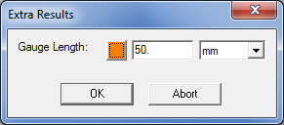
  2. Configuration of Test Setup
Sample Area Tab
Use Specified Sample Height / Gauge Length: (optional)
(Tension or Compression)
Enter the value of the fixed initial gauge length or height of
the sample. This can also be the gauge length of an external
measuring device such as an extensometer when attached
to the sample.
Operator can ‘fine tune’ Sample Height / Gauge Length by: (optional)
A +/- percentage value of the specified value of gauge length can be configured. If the user enters a value outside
of this range, they will be warned and the test will
not start without correcting this value.
When a test is started, the Extra Results message screen appears and the user can type the value and unit scale of
the required Gauge Length.
The Orange button is for advanced use and allows an external measuring devices reading to populate the gauge length entry. (not covered by these notes)

Slide 24
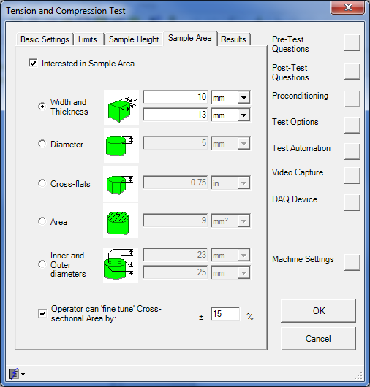
  2. Configuration of Test Setup
Sample Area Tab
Interested In Sample Area: (optional)
Note: The test results can ONLY include Sample Area, e.g. Tensile Strength or Stress, if the “Interested In Sample Area” option has been selected before running a test. This cannot be configured post test.
This screen is where the sample’s original Area
(cross sectional) is entered. The software uses this value for calculation of Tensile Strength and Stress based results.
Area entry can be:
Width and Thickness (Rectangular)
Diameter (Round Sample)
Cross-Flats (Hexagonal)
Area (Cross Sectional)
Inner and Outer Diameter (Tubular Section)
A ‘Fine Tune’ +/- percentage of the specified value of Area can be configured. This controls the value entered exactly the same as shown in previous slide.

Slide 25
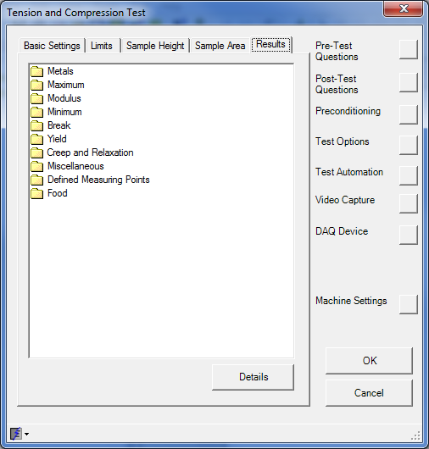
  3. Overview of Results and Extra Measuring Points
Results Tab
Selecting the Results category displays the result categories used in the software. There are many automatically calculated test results that are selectable either before or after the test has been performed.
Some of the results once selected, have fully automatic operation, e.g. Maximum Load
Others require user input or configuration, e.g. Modulus or Defined Measuring Points.
TENSION / COMPRESSION TEST Results: -
• Maximum Values
• Minimum Values
• Break Values
• Upper and Lower Yield Point Values
• Modulus Values
• Rubber Modulus Values
• Creep Values
• Relaxation Values
• "Metals" Values
• User Specified Position Values
• Ring Stiffness Values
• Food Category Results

Slide 26
  3. Overview of Results and Extra Measuring Points
Results Tab
This basic training guide will concentrate on five of these categories:
  Maximum Values
  Minimum Values
  Break values
  Modulus Values
  Defined Measuring Points
All results categories contain a sub-directory that list the type of results available. To see the list of available results types, select the category required and double left click with the mouse. This will expand the view to show the result types available in that category. Double left click with the mouse on the results type to open a new Result Information window. This Window will show all available results with check boxes to enable calculation of a result. A Details tab will can be opened to give a brief description and requirements for results type.
Note: When configuring results, the OK button must be pressed to save the new selections. If the cancel button is pressed, new result changes will not be saved.
A tick mark will appear next to results that are selected.

Slide 27
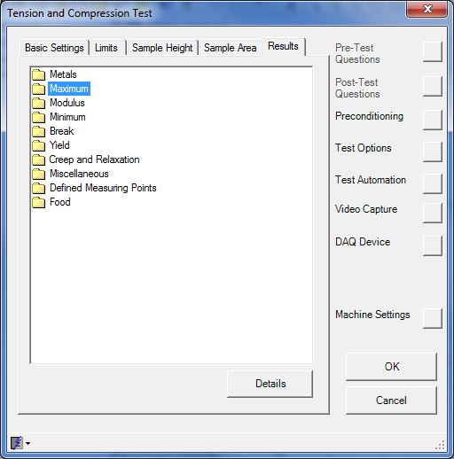
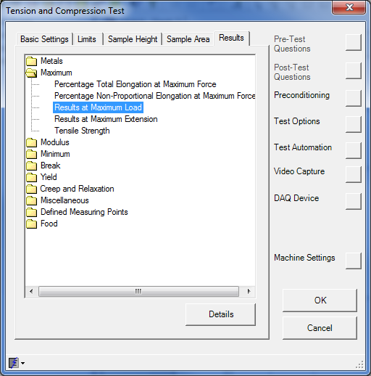
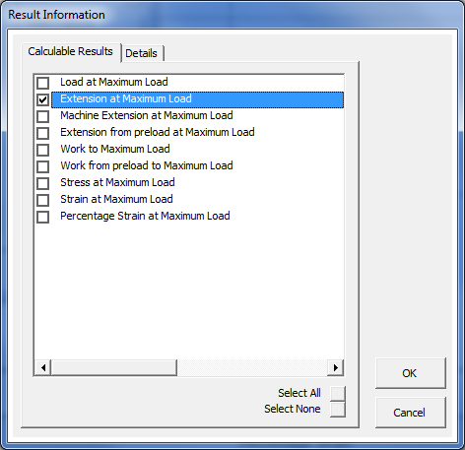
  3. Overview of Results and Extra Measuring Points
Results Tab
To configure a particular result such as “Extension at Maximum Load”, the path would be:
Result Category:
[ Maximum ] Result Type:
[ Results at Maximum Load ] Result Information:
[ Extension at Maximum Load ]
Click OK button three times to save this result for calculation.

Slide 28

  3. Overview of Results and Extra Measuring Points
Results Tab
Maximum Results:
Use the mouse and double left click on the folder icon marked Maximum.
This will show an expanded view of the maximum result type category and list the actual results available.
Percentage Total Elongation at Maximum Force:
This result firstly calculates the point in the test where the maximum force occurs and then draws a line down to the strain axis and calculates the % strain value at this point when compared to the original gauge length. (Sample Height/Gauge Length must be entered in Sample Height Tab)
Percentage Non-Proportional Elongation at Maximum Force:
This result is an advanced strain result and will not be covered in this guide.

Slide 29
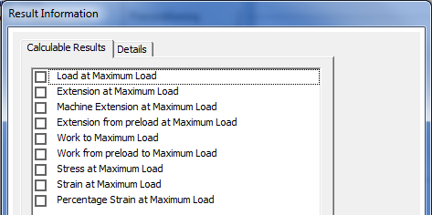

  3. Overview of Results and Extra Measuring Points
Results Tab
Maximum Results
Results at Maximum Load:
Selecting this result type opens the Result Information window and allows selection of the following individual results, all calculated at the Maximum Load point:
Load At Maximum Load
Extension at Maximum Load
Machine Extension at Maximum Load
Extension from preload at Maximum Load
Work to Maximum Load
Work from preload to Maximum Load
Stress at Maximum Load (requires Sample Area)
Strain at Maximum Load (requires Sample Gauge Length)
Percentage Strain at Maximum Load (requires Sample Gauge Length)

Slide 30
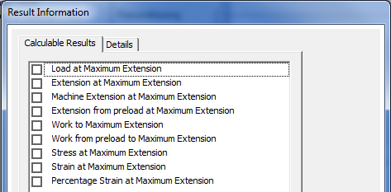

  3. Overview of Results and Extra Measuring Points
Results Tab
Maximum Results
Results at Maximum Extension:
Selecting this result type opens the Result Information window and allows selection of the following individual results, all taken at the Maximum Extension point:
Load At Maximum Extension
Extension at Maximum Extension
Machine Extension at Maximum Extension
Extension from preload at Maximum Extension
Work to Maximum Extension
Work from preload to Maximum Extension
Stress at Maximum Extension (requires Sample Area)
Strain at Maximum Extension (requires Sample Gauge Length)
Percentage Strain at Maximum Extension (requires Sample Gauge Length)

Slide 31
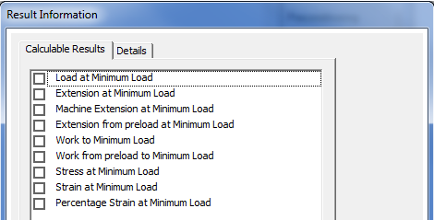

  3. Overview of Results and Extra Measuring Points
Results Tab
Minimum Results:
Results at Minimum Load:
Selecting this result type opens the Result Information window and allows selection of the following individual results, all calculated at the Minimum Load point:
Load At Minimum Load
Extension at Minimum Load
Machine Extension at Minimum Load
Extension from preload at Minimum Load
Work to Minimum Load
Work from preload to Minimum Load
Stress at Minimum Load (requires Sample Area)
Strain at Minimum Load (requires Sample Gauge Length)
Percentage Strain at Minimum Load (requires Sample Gauge Length)

Slide 32
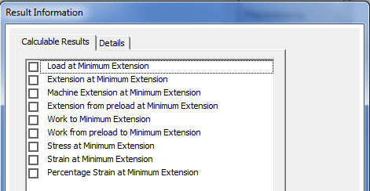

  3. Overview of Results and Extra Measuring Points
Results Tab
Minimum Results
Results at Minimum Extension:
Selecting this result type opens the Result Information window and allows selection of the following individual results, all calculated at the Minimum Extension point:
Load At Minimum Extension
Extension at Minimum Extension
Machine Extension at Minimum Extension
Extension from preload at Minimum Extension
Work to Minimum Extension
Work from preload to Minimum Extension
Stress at Minimum Extension (requires Sample Area)
Strain at Minimum Extension (requires Sample Gauge Length)
Percentage Strain at Minimum Extension (requires Sample Gauge Length)

Slide 33
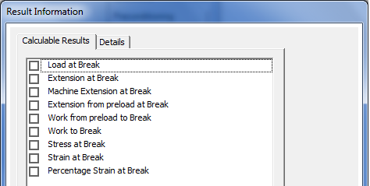

  3. Overview of Results and Extra Measuring Points
Results Tab
Break Results
Results at Break:
Selecting this result type opens the Result Information window and allows selection of the following individual results, all calculated at the detected Break point:
Load At Break
Extension at Break
Machine Extension at Break
Extension from preload at Break
Work from preload Break
Work to Break
Stress at Break (requires Sample Area)
Strain at Break (requires Sample Gauge Length)
Percentage Strain Break (requires Sample Gauge Length)

Slide 34
  3. Overview of Results and Extra Measuring Points
Results Tab
Break Results
Elongation at Fracture:
This result looks for the break point marked on the graph and then draws a line vertically down to intercept the extension data axis. The value at this point is the distance the extension data source has moved to the break point. Units are distance.
Percentage Total Elongation at Fracture:
This result uses original Height or Gauge Length configured and compares this against the distance reading at break point and reports the ratio as a percentage figure of Strain.
(Sample Height/Gauge Length must be entered in Sample Height Tab)
Percentage Non-proportional Elongation at Fracture:
This result is an advanced strain result and will not be covered in this guide.

Slide 35
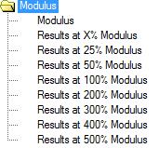
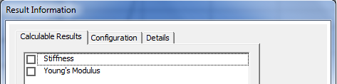
  3. Overview of Results and Extra Measuring Points
Results Tab
Modulus Results
There are two types of Modulus calculation available:
Modulus - This is a calculation based upon a slope or gradient reading taken from the Stress / Strain graph at a defined point.
Results at ‘X’ Modulus - This is also known as the ‘Rubber Modulus’
and is a point drawn upwards from the Strain axis at a percentage value of the original Height or Gauge Length to intercept the graph trace.
Modulus:
Selecting the Modulus results category
opens up two individual results.
Stiffness:
This is the value of a gradient line with units of Force / Distance : (N/mm, lbf/in)
Young’s Modulus
Calculated as per stiffness, but the result units are of Stress / Strain : (N/mm², Mpa, lbf/in²)

Slide 36
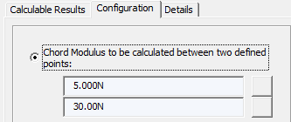

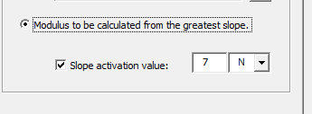
  3. Overview of Results and Extra Measuring Points
Results Tab
Modulus Results
Modulus Configuration
Chord Modulus:
This is two fixed points or values on the graph at
which the gradient/slope will be drawn.
(values can be Load, Extension, Stress or Strain)
Secant Modulus:
This is a single point drawn from the origin (Zero) to a
fixed value. The Slope will be drawn between them.
(value can be Load, Extension, Stress or Strain)
Modulus to be calculated from greatest slope:
The software can automatically look for a greatest slope
point by analysing the graph trace. The user can choose a
value of force as a threshold point, after which the slope
detection will start.

Slide 37
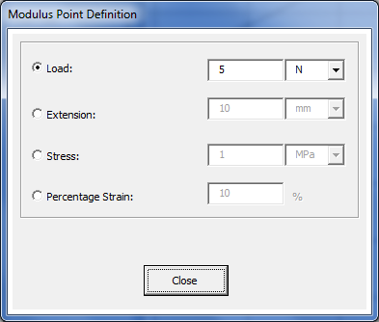
  3. Overview of Results and Extra Measuring Points
Results Tab
Modulus Configuration
Chord Modulus (example):
To select a Chord Modulus between two fixed loads of
5N and 30N, first check the radio button for chord modulus.
When the square button has been pressed from upper and lower chord point values, the definition screen will be shown.
Now select each square button for lower and upper values of chord points
Select the required quantity
(Load, Extension, Stress, Strain)
Then enter the required value and select the correct units.

Slide 38
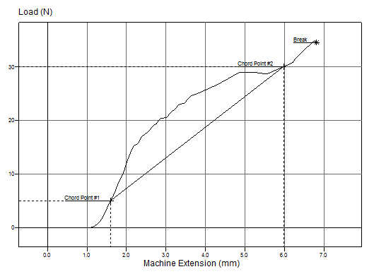
  3. Overview of Results and Extra Measuring Points
Results Tab
Modulus Configuration
Chord Modulus (example):
As can be seen in the graph opposite, the Chord points for 5N and 30N have been marked and the gradient line drawn between them. Values for Stiffness and Young’s Modulus can now be calculated.
(As with all Stress and Strain calculations, Sample Dimensions must be configured)
The Modulus method is used in many advanced calculations such as Offset Yield and After Fracture results. These are not covered in this presentation.

Slide 39

  3. Overview of Results and Extra Measuring Points
Results Tab
Defined Measuring Points
Defined Measuring Points are exactly that . They allow the user to place Markers or Events at required values and can calculate other readings or values at these points. Results with the names of Markers or Events will be created in the results table. Up to 8 Marker and 8 Events can be placed.
Events:
These are defined points on the graph trace given a name, configured at a value and then placed on the graph. Events are not moveable objects and will remain placed at the value configured. Events have the advantage when a test setup must keep the exact measurement points and user intervention cannot take place.
Markers:
These are defined points similar to Events and configured in the same way. The difference is that Markers may be moved to new locations to recalculate values in these new positions. Markers are useful when a test trace may exhibit certain interesting features such as peaks or troughs. The markers can be configured at fixed values, but moved afterwards to new interesting regions or points. Any values or results configured at these points will re-calculate and report at the new position.

Slide 40
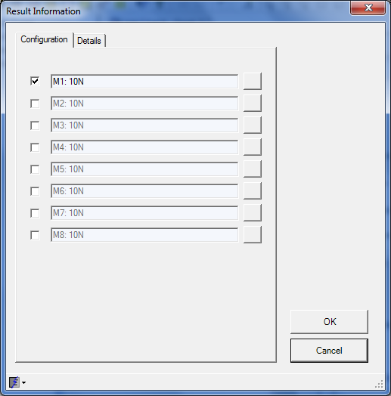
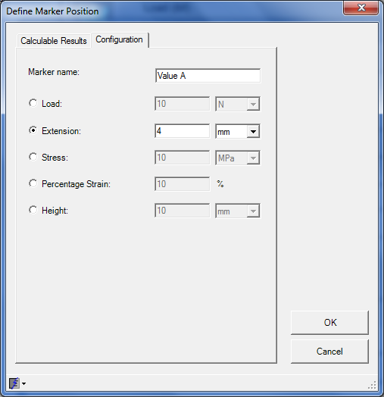
  3. Overview of Results and Extra Measuring Points
Results Tab
Defined Measuring Points
Configuring a Marker or Event:
To place a Marker or Event on the graph trace, firstly select the required result under defined measuring points. In this example we will create a Marker called “Value A” at an Extension of 4mm. We will ask for Load and Stress values at this point. Select Defined Measuring Points (Marker)
The screen below shows the 8 selectable Events.
Place a tick in the top check box.
Then select the square box at the end of the window, to display the define Marker position screen.
Select the Configuration tab.
Enter the Marker Name = Value A
Select the quantity = Extension
Value = 4
Units = mm
Press OK button

Slide 41
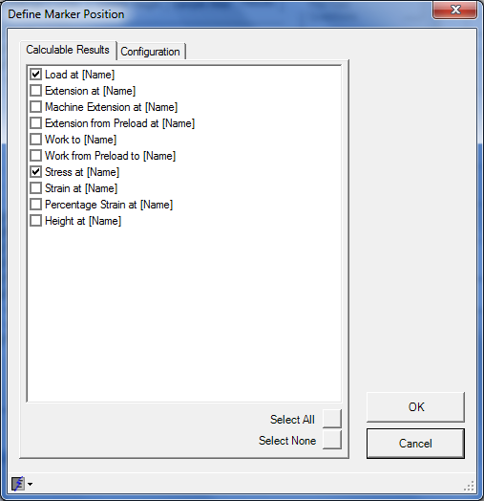
  3. Overview of Results and Extra Measuring Points
Results Tab
Defined Measuring Points
Configuring a Marker or Event:
Select the Calculable Results Tab
Select required results at this Marker, Load and Stress
Press the OK button 3 times to place the marker
The graph above shows the Marker Value A placed at 4mm extension point.
You can also see Load At and Stress At Value A marker name shown in top left hand corner. This is configured by using the ‘show on graph’ option covered in later slides.

Slide 42


  3. Overview of Results and Extra Measuring Points
Results Tab
The corresponding Load and Stress values have changed now that the marker Value A below has been moved to new position of extension = 3mm
Defined Measuring Points
Configuring a Marker or Event:
On the Top Menu Bar of the software is a Move Marker Tool shown circled.
Select this button with Mouse. The mouse pointer icon will change to this symbol. Click on Marker position on graph. Whilst holding the left mouse button slide the Marker along the trace to a new position and release the mouse button. Use the CTRL key in combination with the mouse to move the Marker a greater distance in longer or more complex graph traces.
To reset to normal mouse icon select the arrow key shown circled.
Note : As mentioned earlier, Markers are moveable objects and Events are fixed.

Slide 43
  4. Test Options/Function Buttons
Side Option Buttons - Functions
As well as the Tab functions at the top of the test setup window, there are 8 option buttons down the right hand side of the window. They are:
Pre-Test Questions
Post-Test Questions
Preconditioning
Test Options
Test Automation
Video Capture
DAQ Device
Machine Settings
The function of some of these options will be shown in the following slides.

Slide 44
  4. Test Options/Function Buttons
Side Option Buttons - Functions
When NexygenPlus has been installed, certain display sizes or settings may cause the issue where the side option buttons do not all appear or display correctly on screen.
This is can be corrected by changing the DPI (Dots Per Inch) setting in the display settings of the PC.
For Windows XP: For Windows 7:
Select Start and Control Panel Select Start and Control Panel
Display then Settings Tab Display then Set Custom Text Size (DPI)
Select Advanced then General Tab Ensure the setting is at 100%
Set the drop down box to Normal Size 96 DPI Apply settings to change
Apply settings to change
Note: A log off and log on of an account may be required.
A reboot of computer may also be required.

Slide 45
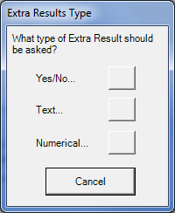
  4. Test Options/Function Buttons
Side Option Buttons - Functions
Pre and Post Test Questions
Pre and Post test questions are provided so that the user can tailor or add extra information to a particular test. These can be sample information, process information or an extra value that must be
reported. These will automatically create a new result column labelled with the question title entered.
Both are created in the same way. A Pre-Test question will appear before a test is started and a Post-Test question will appear on test completion. The Questions can be configured in three main categories:
Yes / No A simple radio style button that the user can check or uncheck. Creates a Boolean result type.
Text... Alpha/Numeric character string stored
as text information.
(What you type is what you see)
Numerical... A question that can be entered as a quantity or number with or without units.

Slide 46
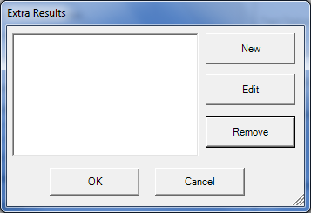
  4. Test Options/Function Buttons
Side Option Buttons - Functions
Pre and Post Test Questions
Configuring a Question
Select the Pre or Post-Test Question button on right hand side of setup window. If a new setup is being configured a blank screen will be shown. Existing questions will be shown if previously entered.
New This will display the new question entry dialogue to assist the user with a new question.
Edit If an existing question is highlighted pressing Edit allows the user to change configuration.
Remove If an existing question is selected, pressing Remove will prompt the user to delete the question from setup.
Note: Pressing OK button saves changes, but Cancel button does not.

Slide 47
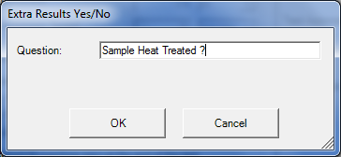

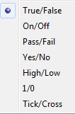
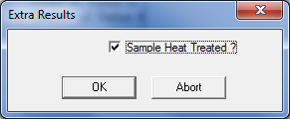
  4. Test Options/Function Buttons
Side Option Buttons - Functions
Pre and Post Test Questions
Configuring a Question
For a new Yes/No question.
Type the required question text
(example “Sample Heat Treated ?”)
4. A Boolean or logical result will be created. Shown as “True” below.
Select Pre or Post-Test question button Then select Yes/No option (circled)
5. This can be changed to the following results type by right clicking the column name and selecting.
3. When the test is started the question plus check/uncheck box will be shown.

Slide 48


  4. Test Options/Function Buttons
Side Option Buttons - Functions
Pre and Post Test Questions
Configuring a Question
For a new Text question.
Select Pre or Post-Test question button Then select Text option (circled)
Type the required question text (example “Batch Number”)
Select result to be Mandatory. Mandatory results must be answered before the test can start. The software will not continue without an answer. The entry dialogue box displayed when the question is shown to the user will always be blank.

Slide 49
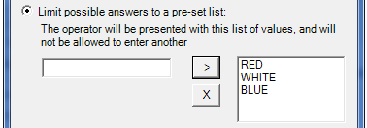
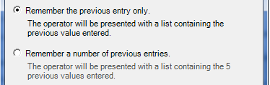
  4. Test Options/Function Buttons
Side Option Buttons - Functions
Pre and Post Test Questions
Configuring a Question
For a new Text question (contd..)
5. The question entry list can be limited to a number of pre-set answers in a drop down list.
Select whether a previous entry will be remembered and shown when the question appears. Or whether a number of previous entries (max 5) will be shown with a drop down list. Note: If Mandatory is selected, A blank entry field will be shown.
Type the answer in the text box
Highlight an answer and press X to remove it from storage
Press the > button to store the answer
This option is very useful if the integrity of answer is critical and can be time saving if answers are detailed.

Slide 50
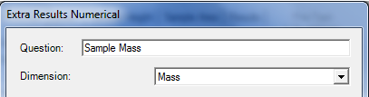
  4. Test Options/Function Buttons
Side Option Buttons - Functions
Pre and Post Test Questions
Configuring a Question
For a new Numerical question.
Enter the text for question and select a dimension if a quantity answer is required. (mm, °C, kg, MPa etc...) The drop down box contains a number of quantity fields for most units.
Select Pre or Post-Test question button Then select Numerical option (circled)
Note: If a unit-less number is required, then dimension
type can be set to ‘None’.
Select result to be Mandatory. Mandatory results must be answered before the test can start. The software will not continue without an answer. The entry dialogue box displayed when the question is shown to the user will always be blank.

Slide 51
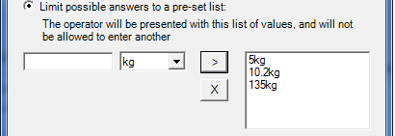

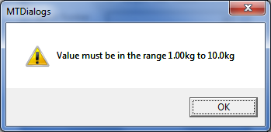
  4. Test Options/Function Buttons
Side Option Buttons - Functions
Pre and Post Test Questions
Configuring a Question
For a new Numerical question (contd..)
5. The question entry list can be limited to a number of pre-set answers in a drop down list.
User can define whether the answer entered must be within a tolerance configured between minimum and maximum values. Values are typed in min and max fields and units are selected.
Type the answer in the text box
Highlight an answer and press X to remove it from storage
Select the quantity units
Press the > button to store the answer
This option is very useful if the integrity of answer is critical and can also be time saving if answers required detailed entry.
A warning message will be displayed if the answer is outside a set limit. The test will not continue until a legal value is entered.

Slide 52
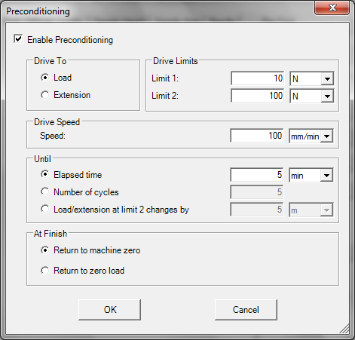
  4. Test Options/Function Buttons
Side Option Buttons - Functions
Preconditioning
The Preconditioning option is the third side button down on the edit setup window.
Preconditioning is an area of the program that will allow a sample to be exercised for a predetermined set of conditions prior to test.
Such things as foams, rubbers or springs, may require such an initial phase of testing to prepare the sample for ‘working’ condition.
The difference between a normal test running and preconditioning stage before a test, is that a graph will not be created during the preconditioning phase and no results will be obtained.

Slide 53
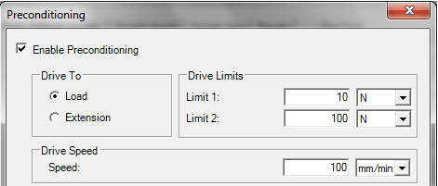


  4. Test Options/Function Buttons
Side Option Buttons - Functions
Preconditioning
Preconditioning is enabled with a check box in the upper left hand corner.
The user can select which type of Limit to drive between using Drive To (Load or Extension), the value of the Drive Limits (limit 1 being lower and limit 2 being upper) and the unit type.
Drive Speed can be set. This will be the speed for both limits.
Until is a condition that will stop the preconditioning phase when a time limit, number of cycles or a measured change in actual Load or Extension between limits is reached.
At Finish The machine will return to it’s set zero point or will drive back to zero load for safe removal of sample if required.

Slide 54
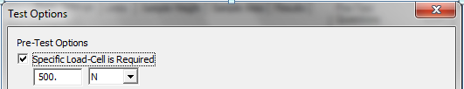
  4. Test Options/Function Buttons
Side Option Buttons - Functions
Test Options
The fourth option button down the right hand side of the setup window is Test Options. These options will be run every time a test is run, before or after a test, regardless of any other automation functions. The options come under four main areas.
Pre-Test Options
Specified Load-Cell is Required
If this check box is selected, then only a load cell of that capacity can be used when starting a test.
This information will be stored with the test file and the load cell fitted to the test machine will be checked each time a test is started. A warning will be displayed if the specified value does not match.
This can be a useful safety feature to prevent damage if a number of load cells are used on a machine.

Slide 55
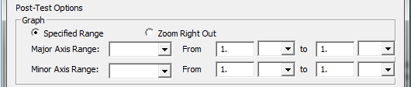
  4. Test Options/Function Buttons
Side Option Buttons - Functions
Test Options
Post-Test Options
Specified Range
Two Axes, Major (X) and Minor (Y) can be set to a defined zoom area at the end of a test. The display range can be entered as lower and upper values with units for both axes.
Note: For this option to work, a test must already be in the batch to create the required axes names.
Zoom Right Out
This option makes the selected X and Y axes re-size to best fit the complete graph trace.
Note: This is a similar function to the tool bar key shown or pressing the HOME key on the keyboard.

Slide 56

  4. Test Options/Function Buttons
Side Option Buttons - Functions
Test Options
Batch
Show:
When a test is completed, a number of different screens can be displayed to the user available in a drop down box. They are:
None Default setting (the graph screen will stay on screen)
Batch Results Screen The screen will show the results table
Statistics Screen Statistics of all the current tests results will be shown
Xbar Range Screen Part of the advanced SPC function showing trend analysis
Histogram Screen A display showing a “Bell Curve” based upon Upper and Lower values.
Note: Xbar or Histogram screens will NOT show any data without Pass/Fail limits set in at least 1 result.
SPC (Statistical Process Control) is not covered in this presentation.

Slide 57
  4. Test Options/Function Buttons
Side Option Buttons - Functions
Test Options
Batch
Auto-Fit Results Columns
When a test is completed, the result columns are automatically resized for best fit to show both Column Header name and it’s contents.
Show Test Failed Indicator
This option will show a dialogue and the test failure. This option requires that Pass/Fail limits be assigned to at least one result column.
(See slide 104 onwards for details on configuring Pass/Fail limits)

Slide 58

  4. Test Options/Function Buttons
Side Option Buttons - Functions
Test Options
Batch
Query
Run Report or Export
This option can be used to automatically print a test report or export test data via a specified method, after a test is completed. This is known as a “Row” report or export.
Pressing the Edit button will bring up the configuration screens for Report or Export functions. These are covered later in this presentation section 8.
The + and – keys open a browse function to allow the user to assign a Query batch to the current test file. A query batch is an advanced filtering option for statistical and QA purposes. This is not covered in this presentation.

Slide 59
  4. Test Options/Function Buttons
Side Option Buttons - Functions
Test Automation
This is the fifth option button on the right hand side of the test setup window.
Test Automation differs in its approach to Test Options, in that, it allows more control of complete test configurations, of more than one test, as a sequence of tests. Anyone with experience of the software predecessor ‘Nexygen MT’, may recognise this as a ‘Batch Tester’ style of operation.
Test Automation features include:
Auto Batch Report Printout
Auto Batch Data Export
"Batch Testing" Mode
Auto File Closing
Auto Start / Stop by digital signal
Start using GO key on console (LS only)
Use of Test Automation allows the user to specify a number of individual test runs into a “Batch” of tests. This can be useful if repetitive testing is required on a number of samples and the same functions are required for all of the individual tests.

Slide 60
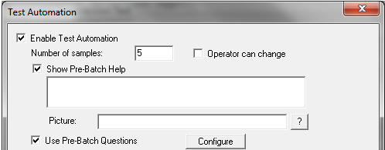
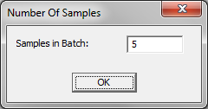
  4. Test Options/Function Buttons
Side Option Buttons - Functions
Test Automation
Test Automation is enabled by selecting the check box on the upper left hand side.
Number of Samples
This is where the “Batch” size or the number of samples to be run under each automation test run is entered.
Checking the ‘Operator Can Change’ option allows the user to change the number of samples after automation has started. This will show the following dialogue:

Slide 61
  4. Test Options/Function Buttons
Side Option Buttons - Functions
Test Automation
Show Pre-Batch Help
This a text field that can will be shown as a prompt to the user before the test starts. This is useful if pre-test operation or configuration must be set before the test is started.
Picture:
By clicking the ? Button, a browse function will open to search for a image (.jpeg / .bmp / .gif) to be inserted. Used in conjunction with the Pre-Batch Help text, detailed instructions for
Pre-test requirements can be shown to the user.
Pre-Batch Questions
These questions are configured in exactly the same way as the Pre-Test question function shown earlier, except for one main difference. Pre-Batch questions are only offered once per sequence of samples set in Test Automation. This can be a common entry such as job number or sample colour.
Note: Text and Picture size cannot be altered. Text is defaulted to the size of Windows screen. Picture size depends upon orientation or shape and will either be best fit horizontally or vertically.

Slide 62
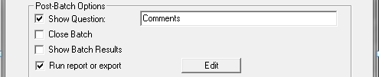
  4. Test Options/Function Buttons
Side Option Buttons - Functions
Test Automation
Post-Batch Options
Show Question
A "Post-Batch" TEXT question can be defined by selecting the "Show Question"
option then entering the question in the field. This question can be used to enter any comments
regarding the "Test Sequence“ that has completed.
Close Batch
The batch file can be closed at the end of a test sequence using the Close Batch option.
Note: This should be used in conjunction with the default Auto-Save option to keep data integrity.
Show Batch results
The display will switch to the Batch Results screen at the end of the test sequence

Slide 63

  4. Test Options/Function Buttons
Side Option Buttons - Functions
Test Automation
Run Report or Export
This option can be used to automatically print a test report or export test data via a specified method, after a batch of tests is completed. This is known as a “Batch” report or export.
Pressing the Edit button will bring up the configuration screens for Report or Export functions. These are covered later in this presentation section 8.
Run Query
The + and – keys open a browse function to allow the user to assign a Query batch to the current test file. A query batch is an advanced filtering option for statistical and QA purposes. This is not covered in this presentation.
The Use Only Data From This Batch Option can be configured so that the functions of the automation only affect the tests run in the current test sequence and not the complete batch file of all tests.

Slide 64
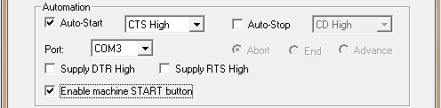
  4. Test Options/Function Buttons
Side Option Buttons - Functions
Test Automation
Automation
It is possible to utilise automation to control, start and stop a test, with the use of a secondary COM port. This presentation does not cover these features, but a presentation is available upon request.
Enable Machine Start Button
It is also possible to enable the start of a test using the Go/►and Stop/█ buttons on the machine console and handheld controller (LS series). This is done by checking the box for this function.
Note: This is a standard operation on LS1 and currently a special function on EZ/Plus series machines.

Slide 65
  4. Test Options/Function Buttons
Side Option Buttons - Functions
Video Capture
The software supports some video capture function. This is a specialist function and only Analogue (web cam) style video capture is supported. No High resolution or digital video support is currently available. This function is not covered in this presentation.
DAQ Device
Using an external National Instruments Data Acquisition device, external readings and signals can be imported into the test software for both measurement and control.
This is again a specialist function and will not be covered by this presentation.
Machine Settings
The last (8th) option button on the right hand side is Machine Settings.
If the correct communication cable and COM port are connected to the test machine, pressing this button will invoke the EZ/Plus software console. Details of the Software Console are shown later in this presentation.

Slide 66
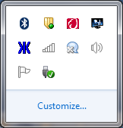
5. Software Console Functionality
EZ/Plus Series Software Console
Overview
All EZ/Plus and LS Series machines use a dedicated protocol and connection to communicate with and be controlled by the NexygenPlus 3 test software.
EZ and Plus series machines use a dedicated 9 pin RS232 com port cable (part number 09/0639)
(USB to Com Port Adaptors can also be used in conjunction with this cable)
LS series machines use a USB (Type A – Computer End) to USB (Type B – LS machine end)
(Part number CBT/1357/00)
The software console runs automatically when the NexygenPlus 3 software is started and will appear as a dark blue asterisk symbol on the active toolbar window as below.
It is always recommended that the software console be started before the test machine is switched on.
The ringed symbol shows that the NexygenPlus 3 console is running (Windows 7 example) and will appear as MTEZCon.exe in software processes.

Slide 67

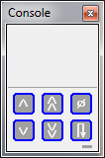

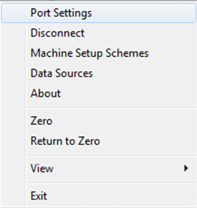
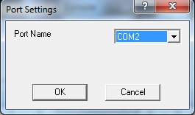
5. Software Console Functionality
EZ/Plus Series Software Console
Overview
The software console can also be started by selecting the Windows button in the left hand corner and selecting ‘All Programs’ then ‘NexygenPlus’ folder. Select the Plus Series Console listed.
If the correct cable is connected and the test machine is switched on and either of the two left hand console windows are shown, it means that the console has not connected with the test machine. This can be a either :
The COM port is being used by another program/application.
The COM port has not been assigned the correct number.
To check the com port number assigned.
Go to Device Manager and look for Ports (COM & LPT) and check the Comp port number that has been assigned in brackets to the desired COM Port.
To assign the correct port number to the console. Right Click with mouse inside console window. Select Port Settings.
Use the drop down box and select the same COM port number listed in device manager

Slide 68



5. Software Console Functionality
EZ/Plus Series Software Console
Features
A successfully connected software console will have buttons coloured in dark blue and a small green rectangle highlighted in the lower right hand corner. The console will either show control buttons only, or Load and Extension readings from the machine.
Options and Settings
Right Clicking with mouse opens the options and settings window.
If the console is not connected ‘live’ to the machine as above, then the options available (shown left) will be limited to the following:
Port Settings
About
View >
Exit

Slide 69
5. Software Console Functionality
EZ/Plus Series Software Console
Options and Settings
Port Settings:
This where the available COM Port numbers are listed. Use the drop down box to select the correctly numbered port.
Connect / Disconnect:
This option will change depending upon the connection status of the COM port. Connect will attempt to force connection to the software console if has not done so automatically. Disconnect will force a disconnect of the console. Note: This will be followed by a reconnection of the console if available.
Machine Setup Schemes (connected only):
This option controls a number of safety and machine controls. It is recommended that the function of each option be understood before changing any of the default settings.
Details of each option are listed on the next few slides.

Slide 70

5. Software Console Functionality
EZ/Plus Series Software Console
Options and Settings
Machine Setup Schemes (contd..):
The Scheme shows the current name of the scheme being used. On a standard installation, only one scheme name will be shown ‘Default’.
It is possible to have more than one scheme stored on the computer. NexygenPlus will remember which scheme was running when the last test ran and will store this in the batch file.
The next time a test is run in that batch a warning will be given to the user, if the scheme as been changed. The advantages of this are:
  Prevents any incorrect settings to be used with a test and particular sample
  Warns the user a different load cell may be needed or has been fitted since the last test
  Allows individual fine tuning of machine settings, such that a test can be assigned dedicated settings to match a particular sample’s performance characteristics.
  The drop down box will list all current schemes configured and stored. The Delete key will remove the current scheme and drop back to the next available one. Note: It is not possible to delete all schemes.
  One scheme must be kept in memory. The user will be warned so, if that is the case.

Slide 71

5. Software Console Functionality
EZ/Plus Series Software Console
Options and Settings
Machine Setup Schemes (contd..):
Compressive and Tensile Load Limits are used as a form of safety and protection to the User, Load Cell, Machine and Grips fitted.
It is possible to stop a test if a load limit condition is reached in either Tension or Compression. This will abort the current test and a warning message that the “Load Has Exceeded Safety Limit” will be displayed.
The value of limit is typed in the left hand box and the unit of load is selected in the right hand drop down box.
It is possible to set differing limits in either mode, but it is NOT recommended to set the limit in either mode higher than the load cell connected or machine being used operating capacity.
The load limits will be stored as part of the Machine Setup Scheme and will be saved with the batch file.
Note: Upon a default installation of NexygenPlus, the machine scheme is “Default” and both Tension and Compression limits will be set to 100N. This can cause an error if using a larger load cell the first time and will require the user to set appropriate values for load cell or machine being used.

Slide 72

5. Software Console Functionality
EZ/Plus Series Software Console
Options and Settings
Machine Setup Schemes (contd..):
Extension Readings is used to display and configure which extension data source is required to record readings and store them to the software.
The software, by default, is set to read from the machine’s internal extension readings. This will be indicated by the machine type, software version and serial number listed in the drop down window.
It is possible to have another (single) external extension input on the EZ/Plus series machines. Up to three (with use of external interface) extension inputs on the LS series machines. Such devices would be Extensometer, Deflection Gauge, or LVDT. Both series of machines require connection through a smart plug which will hold Type, serial number and calibration information of each external device. These, if connected, will be listed in the Extension Readings drop down box.
The Configure and Extensometer Range options are used in conjunction with some specific external measuring devices such as an optical ranged extensometer.
Note: Failure to select the correct extension source prior to starting a test may result in incorrect operation and wrong extension results.

Slide 73


5. Software Console Functionality
EZ/Plus Series Software Console
Options and Settings
Machine Setup Schemes (contd..):
Stiffness Compensation is used to alter the way in which the machine and software reads or controls in line with a sample’s characteristics. It is NOT advised to change these settings unless it is understood the affect they may have on operation and results.
Sample Stiffness is, by default, set to Automatic and should be left so under all normal operations.
Selecting the + symbol for sample stiffness, displays a window to select Automatic or Manual.
Manual Sample Stiffness mainly applies to load holding tests. When the machine holds load, it tracks the sample movement and corrects the position of the crosshead to keep the required load applied. In some cases this can cause loss of load hold and oscillation of machine movement (particularly in stiffer samples). By measuring the sample’s stiffness in N/mm² (usually the most linear part of the ‘elastic’ stress/strain curve) the actual stiffness value can be entered to tune the machine’s behaviour. This should result in a better response from the machine during the load holding stage.

Slide 74
5. Software Console Functionality
EZ/Plus Series Software Console
Options and Settings
Machine Setup Schemes (contd..):
Machine Stiffness is used to compensate for any erroneous or unwanted movement in the complete load train. This may apply to machine, load cell and grips and, when applied, gives a truer reading of sample performance in terms of movement.
This can be important if for example a sample is tested on two different machines or with two different capacity load cells.
The compensation scheme is run either in the machine’s interface console (EZ/Plus and LS series) or within the software console “Perform Machine Stiffness Configuration” (LS series only).
Note: This presentation will not cover these settings, but information and assistance is available from Lloyd Instruments Ltd.

Slide 75

5. Software Console Functionality
EZ/Plus Series Software Console
Options and Settings
Machine Setup Schemes (contd..):
Data Rate is the sample rate at which readings of the data sources are taken and stored in the software console.
As each test is performed, the console takes readings from the machine at the data rate assigned and uses these to plot the graphical information from which, results are taken. The longer and more complex the data read (such as creep/relaxation tests or friction or peel tests), the larger the NexygenPlus batch file will become.
In such cases where some parts of a long term test are not of interest, it is possible to drop the sample rate of the console.
By default the sample rate of the console is 1000Hz (1000 readings of load and extension per second)
By selecting Reduce Data Rate the number entered is used to a fraction against the original 1000 set.
e.g. setting a rate of 10 will be 1000/10 = new sample rate of 100Hz
setting a rate of 200 will be 1000/200 = new sample rate of 5Hz

Slide 76

5. Software Console Functionality
EZ/Plus Series Software Console
Options and Settings
Machine Setup Schemes (contd..):
Safety Jog Load option sets the load limit at which the machine will stop when being moved with the jog keys. This is a safety limit for the user and machine when setting the machines position
Slow Jog Speed is the speed for the single chevron ˄ or ˅ keys on the hand held option.
Noise Filtering Override:
This is an advanced engineering function and should not be used unless instructed to do so. Use of this option will affect sample readings and possibly affect machine control.

Slide 77


5. Software Console Functionality
EZ/Plus Series Software Console
Options and Settings
Machine Setup Schemes (contd..):
When all the changes have been made to Machine Setup Scheme, the user must select Save As... Option. This will provide a Save Scheme window in which the current scheme name will be shown. To overwrite the existing scheme click OK. To enter a new scheme name, type the new name in the text box and click OK. The next time the machine setup scheme is opened, the drop down window for Scheme will show the existing and newly created scheme.
To select a scheme to use, highlight that scheme from the drop down window, click save as and then click OK.
This scheme will now become active and the settings will be used with the next NexygenPlus test.
Note: Pressing Cancel at any point will lose any settings changed.

Slide 78

5. Software Console Functionality
EZ/Plus Series Software Console
Options and Settings
Data Sources:
Selecting Data Sources will list the devices connected to the connected test machine by index number , type of input (Load, Extension), description of the device and serial number.

Slide 79

5. Software Console Functionality
EZ/Plus Series Software Console
Options and Settings
About:
Selecting About lists the software console version and the details and embedded software version of the machine it is connected to.
Note: This can be useful when a Technical Support enquiry is raised.
Zero and Return To Zero:
The Zero and Return To Zero operate the same way as the (zero) and (return to zero) keys on the software console.
Note: Zero will zero all data sources and Return To Zero will return machine to last home position.

Slide 80


5. Software Console Functionality
EZ/Plus Series Software Console
Options and Settings
View:
Flat Panel
Show Load and Extension
To show or hide the actual machine readings
N / lbf and mm / in
Switch between either Metric or Imperial units.
Exit:
Close the console settings window.

Slide 81

6. Batch File Operations and Features
Main NexygenPlus Screen
Overview
Batch File Name
Batch File Selection Tab
Batch File Results Columns
Results Screen Toolbar
Control Panel
Window
This is the screen that will be seen if an existing batch file containing tests data is opened.
Test Row Number
NP3 Software Console
(Connected)
Row Number Indicator
NP3 Screen Tabs

Slide 82
6. Batch File Operations and Features
Main NexygenPlus Screen
Overview
Batch File Name:
This is where the current batch file’s saved name is displayed.
Batch File Selection Tab:
It is possible to have more than one batch file open at any one time within the NexygenPlus screen. The tabs show the batch file name of each test opened. However, only one batch file can be run on a machine at any one time. Any saved Machine Setup Schemes stored with any particular batch file will also be remembered when switching batch files and the user will be warned if a different scheme is currently selected.
The current batch file when selected will be indicated as the tab shown forward in focus.

Slide 83



6. Batch File Operations and Features
Main NexygenPlus Screen
Overview
Results Screen Toolbar:
File
Open, Save and Save As.. perform as standard Windows functions They are used to open a new batch file or save the file with the same name and location or different name or location.
Save to Standards Library will store the current batch file in a dedicated area in the Shared folder. When a batch file is configured fully, it may be decided that this can be used as a Master Template File. This is used in conjunction with the Welcome Screen option Create Batch From Standards Library.
The user is offered a list of batches stored in the standards library and to enter a new batch file name that will use the same settings.
A newly created batch will be opened for use.
Note: To use the save to standards library option, the results screen must be displayed and in focus (selected).

Slide 84

6. Batch File Operations and Features
Main NexygenPlus Screen
Overview
Results Screen Toolbar:
File
Close will exit the NexygenPlus software.
Archive Now if archive settings are used, runs the archive operation.
Export will create a basic .CSV export file of all test data displayed.
Print.., Print Preview, Print Setup and Page Setup are used to manage and create a screen print of the results table as is displayed.
Send.. Will invoke the default email program if installed on the PC and prepare a new email screen with the batch file as an attachment.

Slide 85



6. Batch File Operations and Features
Main NexygenPlus Screen
Overview
Results Screen Toolbar:
Edit
When single or multiple rows are selected, the user can Cut, Copy, Paste or Delete.
Cut/Copy/Paste can be to another batch file or external document in text form.
Got To Row... Allows the user to enter a specific valid row number which the software will jump to (useful in larger batches).
Clear Pass/Fail limits will remove any limits applied to Result Column or test row.
Select All will highlight all rows shown in the results screen.
Insert New Test inserts a new test row repeated from the last.
Repeat This Test allows an existing row to be highlighted and repeated.
Open Test will open the setup window of a highlighted test row.
Use As Nominal Results allows any result quantity to be used as the nominal Pass/Fail limit value. The default setting is 10% of the nominal value.

Slide 86


6. Batch File Operations and Features
Main NexygenPlus Screen
Overview
Results Screen Toolbar:
Edit
Test Automation opens the settings screen for test automation
(batch).
Test Options opens the settings screen for test options (row).
SPC settings opens an entry screen to configure the subgroup size used for the statistics functions. (Default = 5 rows).

Slide 87

6. Batch File Operations and Features
Main NexygenPlus Screen
Overview
Results Screen Toolbar:
View
Select whether the Toolbar is shown.
Select whether Column Headers are shown or hidden.
Selects whether the Row Number is displayed or hidden.
Status Bar shows/hides the test row information at the bottom of the graph screen.
Show Pass/Fail Status is used in conjunction with the default Boolean result Sample Passed. The rows will change colour accordingly.
Note: A batch with no Pass/Fail limits configured will default the Sample Passed result to True or Pass

Slide 88

6. Batch File Operations and Features
Main NexygenPlus Screen
Overview
Results Screen Toolbar:
View
Show/Hide Columns allows the user to select which column headers and respective results are to be shown in the results window.
The View Columns window shows all ‘historic’ column header names that have been created in the batch file. Checking or un-checking the box next to the result name will add/remove the result from the visible results screen.
Renamed results from the original column header name will update in the list of view columns.
Note: Result Columns with Pass/Fail limits applied will still give Pass/Fail indication even when hidden.

Slide 89


6. Batch File Operations and Features
Main NexygenPlus Screen
Overview
Results Screen Toolbar:
View
Row Query... allows the user to select Passed or Failed rows and respective results are to be shown in the results window.
Pass/Fail limits must be applied to at least one result column for Row Query to be used.
Results that have passed or failed can be selected and a warning will be given to the user if there are no results with the status selected. The user is asked if all the rows should be displayed in this instance.

Slide 90


6. Batch File Operations and Features
Main NexygenPlus Screen
Overview
Results Screen Toolbar:
View
When single or multiple rows are selected in the results screen, the View menu offers to either Hide Selected Rows or Show Only Selected Rows. This can be useful for isolating individual tests or sequences within large batch files. Show All Rows will be active if any rows within the batch are hidden.
The current screen can be changed between Results, Statistics, Xbar/Range, Histogram, Graph by selecting the option. This is the same function as selecting the Tabs at the bottom of the display screen.
If rows have been deleted, Deleted Rows will display the information.
Row History gives details of any changes to a row.

Slide 91



6. Batch File Operations and Features
Main NexygenPlus Screen
Overview
Results Screen Toolbar:
Report
The Report menu contains 8 functions for creating a Row (single result) or Batch (multiple results) report. Selecting the Report option will use the existing template stored with the batch information. If the batch is new or Report As is selected, then the user will be prompted to find the MS Word™ report template that has been preconfigured to produce a Row or Batch report.
Email options will open the default email program used (if closed) and insert a blank email with the report attachment.
Optional Tags displays the current settings for
graph tags used to make attachments in report
templates.
Batch Report Designer is detailed in section 7 of this presentation.

Slide 92


6. Batch File Operations and Features
Main NexygenPlus Screen
Overview
Results Screen Toolbar:
Format
Format option allows the user to change the display Header Font used in the result column header or the Results Font for actual result text listed.
If any columns widths are narrowed, causing text to be cut off or hidden, then selecting Show Widest In Column will resize the column width to display full information.
Help
Help Topics displays the in built help menus within the software.
About Batch will display the NexygenPlus version, Module information and Build Number. (this information is useful when making a technical enquiry).
Lloyd Instruments Online will take the user to the Lloyd Instruments Ltd home web page (if an internet connection is available).

Slide 93


6. Batch File Operations and Features
Main NexygenPlus Screen
Overview
Control Panel Window:
This panel contains several options for configuring new test files, default software units, macro control and test file storage and configuration options.
Test Types: Lists the tests available and can create (by right mouse click) new batch files.
Configuration: Shows the Default Units quantity and the current units that will be displayed, in brackets.
By right clicking on any of the default unit names, a configuration screen can be used to change the current settings.
Testing Machine: Used to configure the software console options.

Slide 94


6. Batch File Operations and Features
Main NexygenPlus Screen
Overview
Control Panel Window:
This panel contains several options for configuring new test files, default software units, macro control and test file storage and configuration options.
Macros:
Macros can be configured and used to control the way the software runs upon opening and closing. These are advanced controls and will not be covered in this presentation.
Data folder is the folder location to where all working batch files are stored and listed. This can be locally on the computer, or a network location.
Data folder functions are listed on the next slide.
Data:

Slide 95
6. Batch File Operations and Features
Main NexygenPlus Screen
Overview
Data Folder
The data folder is where all current batch files, report templates and query files are stored. When the software is first installed the default file path can be reconfigured during the install process itself. This is only recommended if the person installing the software is aware of the PC configuration or Network environment. Otherwise the default file path is to be used initially. The default path is as follows:
Windows XP:
C:\ Documents and Settings \ All Users \ Lloyd Instruments Ltd \ NEXYGEN Plus \ Shared
Windows 7:
C:\ Program Data \ Lloyd Instruments Ltd \ NEXYGEN Plus \ Shared
Note: The Program Data folder in Windows 7 is a hidden folder type and if it cannot be seen in explorer mode, it will be necessary to set the file options to show it.
Go to Control Panel, Folder Options and select View tab. Ensure that the option “Show Hidden Files, Folders and Drives” is checked. Ensure that the option “Hide extensions for known file types” is unchecked. If in doubt contact the relevant on-site I.T contact.

Slide 96


6. Batch File Operations and Features
Main NexygenPlus Screen
Overview
Data Folder
Checking the Data folder location:
Once installed, the Data folder path can be checked by holding the mouse pointer over the Data folder. A window will display the current file path.
Changing the location of the Data folder:
Highlight the Data folder with the left mouse button (Blue)
Right Click with the Mouse
Select the bottom option Data Folder to show the Data Properties Window
Use the ? Button to open a browse function and navigate to the desired computer or network location and select OK.
Confirm the new Data folder location by the method above.

Slide 97

6. Batch File Operations and Features
Main NexygenPlus Screen
Control Panel Window
By selecting the + symbol beside the Data folder will show all stored batch files. Highlighting a batch file will bring up a new window panel of options.
Some of these are basic functions of any Windows folder such as New (Folder/Query/Batch), Open, Delete, Rename, Copy and Cut.
We will concentrate on 4 functions that are important during initial installation and during the operation of the software. They are:
Repeat
Auto Save
Auto Archive
Reasons
Batch File Functions

Slide 98


6. Batch File Operations and Features
Main NexygenPlus Screen
Control Panel Window
Repeat is used to create a new batch file, with the exact same settings and controls. The last test listed (either completed, or a new test), in the existing batch file will insert a new blank row in the batch file created. The row number in the new batch file will be reset to 1. Type the name of the new batch file in the text box.
Auto-Save controls how the batch file will be saved to the Data folder. The batch file can be saved
Manually (User selects File Save/Save As or icon)
After a Time Period (from computer time settings)
Save after each test
This is the default and recommended setting that ensures integrity of test data.

Slide 99

6. Batch File Operations and Features
Main NexygenPlus Screen
Control Panel Window
Auto-Archive Settings
Auto-Archive is one of the most important settings within the software. As mentioned previously, NexygenPlus can run at high sample rates, which in turn can create a lot of data. This data is stored in each batch file and can lead to longer process time when opening/closing of batch files and operation (test automation) depending on settings. The main advantages of archiving regularly are:
Keeps the working batch file to a manageable size.
Keeps data integrity if/when stored to a network or drive.
Allows batch files being archived to be used for Quality Analysis purposes over a long time period.
When used in conjunction with Test Automation (set number of samples) can keep a clear record of time/date activity for Time Management or Process review.
Note: Failure to use the Auto-Save and Auto-Archive functions can lead to loss of test data.
Files will not be retrievable within the software without correct storage settings.

Slide 100

6. Batch File Operations and Features
Main NexygenPlus Screen
Control Panel Window
Auto-Archive settings contd...
The archive settings are used in conjunction with the Timestamp information saved in each batch file. Timestamp information is taken from the computer clock settings and is an automatically created result. The Timestamp result consists of Date and Time and is shown in the format: DD/MM/YYYY HH:MM:SS
When an archive function is performed on a batch file, a copy of the batch information is made and a newly created batch file is left in place of the old one, with the same batch filename. The archived batch has added to it’s filename, the first and last test row’s timestamp information.
For example: A batch file named Grab Tensile contains
458 results that need to be archived:
The timestamp information of first and last tests are:
Once Archive has been performed the batch filename is
stored in the archive folder as:

Slide 101



6. Batch File Operations and Features
Main NexygenPlus Screen
Control Panel Window
Auto-Archive settings contd...
Archive Manually is the default setting with the archive settings
and is exactly that. The user can choose when the batch file is to be archived. To use this option the results screen must be shown as the main screen and the mouse must be clicked inside this window, to make it the active (focused) area. The user then selects the Toolbar function File then Archive Now.
Note: If the screen selection is not done, the Archive Now option will be ‘greyed out’ and not selectable.
The user is warned that the batch is ready for archiving and pressing OK will perform the archive function. A progress bar will be displayed whilst the operation takes place.

Slide 102



6. Batch File Operations and Features
Main NexygenPlus Screen
Control Panel Window
Auto-Archive settings contd...
Archive (By Time) can be configured by the four options shown. When the last test’s timestamp in a batch being used, meets the change in criteria (next day, week etc...), the user will be warned that the batch is ready for archive. Again pressing OK will perform the archive function to the selected archive folder.
Archive (Number of Tests) is useful if a set number of tests is required per archive batch or if test automation (groups of tests) is being used.
A maximum of 500 tests is recommended for a standard style of test setup.
Archive to (file path) is used to set the location of the archive folder. Selecting the button (circled) will open a browse function to choose the destination file path. Default is the Shared/ Data folder for the appropriate Windows version mentioned in earlier slide.

Slide 103


6. Batch File Operations and Features
Main NexygenPlus Screen
Reasons is an option to record, in text format, any changes that are made to the test setup in between tests. This is of interest if batch file settings need to be changed per test or sample, a record will be kept. Reasons are stored in Row History.
The Reasons screen will appear if set when the test is edited and a change made.
The options are:
Not Recorded (No prompt box)
Optional (text maybe typed or left blank)
Mandatory (text must be entered, test will not continue without)
Control Panel Window
Reasons
When either Optional or Mandatory reasons are selected and a change is made to the setup, the reason for changes text entry window will appear.
If Mandatory is set, then this screen will not disappear until a text entry is entered.

Slide 104


6. Batch File Operations and Features
Main NexygenPlus Screen
Control Panel Window
Reasons (Row History)
Reason changes if enabled, can be displayed from the results screen for the test row that has changed. To do this, select the row number on the left hand side of the row itself, right click with the mouse. From the drop down menu, select Row History.
This will show the screen below with the date time and Reason entered for changes to the test setup.

Slide 105

6. Batch File Operations and Features
Main NexygenPlus Screen
Test Row Numbers
Row Numbers are used to index the tests within a batch. Each Row represents a sample that has been tested in the batch.
If for any reason a test row has been hidden or deleted, the sequence of numbers will indicate this as shown opposite.

Slide 106


6. Batch File Operations and Features
Main NexygenPlus Screen
Test Row Numbers (cont.)
When a test has more than one result with a Pass/Fail criteria, it may not be easy to see which result has passed and which has failed. To check a result status, select the required Row Number. Right click on the Row identification number and select Properties to show the Pass/Fail Status of this test.

Slide 107

6. Batch File Operations and Features
Main NexygenPlus Screen
Screen Tabs
Results: Displays the Results Screen in a Spreadsheet format.
Graph: Displays the Graph Screen of the currently selected test row.
Statistics: Displays the Statistics of the current results. Will only display the statistics for Visible rows. Hidden rows will not be included in statistics values.
XBar/Range: This is an SPC Function that is applied to sub-group values and their trend analysis within batch. This is not covered in this presentation.
Histogram: This is a SPC function that will produce a Bell Curve chart based upon Upper and Lower Pass/Fail limits. This is not covered in this presentation.

Slide 108


6. Batch File Operations and Features
Main NexygenPlus Screen
Row Indicator Number:
The Row Indicator number tells you how many rows are currently in this batch.
In normal operation this is the total number of results, however if some results are hidden, this number will change to show the number of currently displayed results out of the total number in the batch.

Slide 109



6. Batch File Operations and Features
Main NexygenPlus Screen
Batch File Results Column:
Whilst the Results screen is displayed in NexygenPlus, individual results are stored by column across the screen. Right Clicking with the mouse, within the Column Header reveals a number of options.
Column Headers Visible selects whether the headers are displayed on the results screen.
Show On Graph will enable or disable whether the column header name and result information for the individual row is displayed on it’s corresponding graph screen.
Copy allows the column header and any associated result information to be copied and pasted as basic text information to another area or program.

Slide 110



6. Batch File Operations and Features
Main NexygenPlus Screen
Batch File Results Column:
Header Font.. and Results Font.. Allows change to the text properties (colour, font type etc..) of the header and results.
The number of decimal places or significant figures used to display results, can be quickly set here if one of these 6 criteria are required. Further settings are available in the Properties option.
The lowest part of the configuration window shows the currently selected unit used for that result quantity. It also lists alternative unit types currently configured and available in the software. These can be checked to change the units displayed in results and reports.

Slide 111



6. Batch File Operations and Features
Main NexygenPlus Screen
Batch File Results Column:
Selecting Properties opens the Column Properties window. This is where changes to the Column Header and Results listed can be altered.
Title tab, displays the current name of the Column Header. The default result name will be displayed, but can be changed by entering new text in the Column Title entry box. Pressing the Set To Default button sets any altered column header names back to the default name when created.
Note: The default column header name is always used by the software for report printing, regardless of the Column Title name displayed in results.
Appearance tab allows the column width to be set by use of a sliding bar and the column to be hidden via a checkbox if not required.

Slide 112


6. Batch File Operations and Features
Main NexygenPlus Screen
Batch File Results Column:
Format tab sets how the results values look in terms of decimal places or significant figures, by selecting the number in the Precision: window.
Units: offers the selection of stored unit options available for the result type.
Thousands separators: if selected will apply the windows set separator (usually comma or decimal) when larger digit numbers are being displayed.
An Example of the result format is displayed with the current settings.
Statistics Tab shows the current statistics calculations based upon the columns visible row result data.
Copy allows a text copy of the data to be pasted to another program or area.

Slide 113

6. Batch File Operations and Features
Main NexygenPlus Screen
Batch File Results Column:
Limits tab is used to apply Pass/Fail limits to a results column.
This is used for indication purposes or for the SPC statistics functions not detailed in this presentation.
No Limits Pass/Fail limits are not used on this result column
Relative To Nominal A nominal value is entered into the text box with relevant units. A +/- percentage figure is configured as a range that the result must be within to register a Pass.
Within Range Two defined values may be entered as the range options. The first (top text entry) is the lower limit and the second (bottom text entry) is the upper limit. Result value must be within these values to register a Pass.
Note: Multiple columns may have an individual limit applied to each within the batch.

Slide 114


6. Batch File Operations and Features
Main NexygenPlus Screen
Batch File Results Column: Pass/Fail limits Examples
A result “Load at Maximum Load” has 5 rows of data.
Pass/Fail limits are applied within a range from 63.8 N to 66 N.
The result screen when now viewed shows the result status in Green (Pass) and Red (Fail), the row values for Load at Maximum Load.
With Pass/Fail limits applied, the Sample Passed column will now indicate a Boolean result (Pass/Fail, Yes/No, 0/1 etc..)

Slide 115




6. Batch File Operations and Features
Main NexygenPlus Screen
Batch File Results Column: Pass/Fail limits Example
The batch file has both “Load at Maximum Load” and “Machine Extension at Maximum Load” with Pass/Fail limits applied:
Now that there are two applied column limits to the batch, only results that pass within both set limits are shown with Pass indication.
The Pass/Fail status and colour of row 4 shows a fail. It may not be clear to the user why this row has failed.
To check the row for Pass/Fail indication, right click with the mouse on the row number and select the bottom option Properties. This will show the Test Properties window and list the Status for each result with a Pass/Fail limit in that row.
Note: Row 5 would appear to have passed the extension result, given the applied ranges above. However, the result column is configured for 3 decimal places, but the actual result value has further decimal values not shown.

Slide 116



6. Batch File Operations and Features
Main NexygenPlus Screen
Batch File Results Column: Creating an Overlay Graph
Overlay graphs are a useful tool for comparing a number of test traces together on one single graph screen.
To create an overlay:
Select the row in which the overlay will be displayed
2. Using Shift and Ctrl keys select the interesting rows
3. Press the enter key on the keyboard
Press enter or select ‘Yes’ to prompt message
The graph display will show multiple coloured traces
Row numbers will be displayed if Overlay Legend is enabled

Slide 117


6. Batch File Operations and Features
Main NexygenPlus Screen
Graph Screen
Toolbar Menu
Overlay Legend
Graph Number
Minor Axis
Major Axis
Edit
New
Keys
Graph Display

Slide 118
6. Batch File Operations and Features
Main NexygenPlus Screen
Graph Screen
Graph Number This is tied to the row number of the test being displayed. It will change when the left and right arrows to change graph are pressed. Graph numbers may skip a number in a sequence, because that row has been deleted from the results table.
Minor / Major Axis The Minor and Major Axis drop down boxes are only populated once a graph has been created. They are used to choose the X and Y axes that will display the graph trace of data points. A newly created test will show blank fields.
Edit The Edit button will open the test setup editor for the current test. It is used to configure a newly inserted test or edit the settings of an existing setup.
New / Start This button will display New on any existing tests graph screen. Pressing this button will insert a new test with the settings of the last stored row in the batch. When the graph screen is set to show a newly inserted test, the graph will be blank and the New button will change name to “Start” in green. Pressing the Start button will run the current test.
Keys Navigate the graphs of results stored. Graph number and Row number will change accordingly.

Slide 119



6. Batch File Operations and Features
Main NexygenPlus Screen
Graph Screen
Graph Display
By Right Clicking with the mouse inside the graph window, the following options appear.
Copy / Paste functions allow the graph to inserted as a picture into another location or software. Paste also allows other objects to be pasted to the graph screen.
Note: It is not standard practice to use these options. These functions can be computer memory intensive and may cause PC system warnings to be displayed.
Data Point Export Allows graph trace data points to be exported
to another software package such as Excel. The data can be the complete test or between two valid time values over the test duration. The time values are entered in the Test Section area when Export Section is selected.
Number of Data Points can bet set to a maximum of 16384.

Slide 120

6. Batch File Operations and Features
Main NexygenPlus Screen
Graph Screen
Graph Display
Export points on the following axes: allows the user to choose which data axes are included in the export.
Export to File... Can be used to export data as text to another file location.
Copy to Clipboard allows the data to be copied to the Windows clipboard and used in that mode.
Note: Caution must be used when exporting data points. It is possible to export more data points than those that were recorded from the machine (through interpolation). This may be the case in short term tests or tests performed with reduced sampling rates. It can lead to errors, for example, when re-creating graphs externally from data points exported.
(The graphs may not look the same as points may have been omitted or created in the export data).

Slide 121

6. Batch File Operations and Features
Main NexygenPlus Screen
Graph Screen
Graph Display
Selecting Properties will display the Graph Properties window.
Graph Paper tab is used to set the style of graph display and size.
Graph Shape can be Square or Rectangular, which may suit certain computer display types.
Graph Size has four options Small, Medium, Large and Extra Large. Again, this may suit certain computer display types.

Slide 122


6. Batch File Operations and Features
Main NexygenPlus Screen
Graph Screen
Graph Display
Axes tab selects the Major and Minor axes to be displayed in the graph window.
The other tabs displayed are based upon axes that have been created during the test and will vary between test setups or types. The user can specify within each of these tabs what display ranges the graph can be zoomed to (Upper and/or Lower Limits) and the Unit Values displayed. Changing the unit type changes to graph axis unit type to match.
Zoom Right Out can be selected to either set the origin of the graph to the Lower LHS or the Centre of the graph screen.

Slide 123
6. Batch File Operations and Features
Main NexygenPlus Screen
Graph Screen
Graph Display – Overlay Legend
The Overlay Legend is selected from the Windows Menu on the graph screen by the View menu then selecting Overlay Legend.
This will display the graph numbers that have been created for the overlay graph in a list. The list displays uses pre-defined colours to identify individual test graphs to the corresponding graph number.
The overlay display can be cleared in the View menu by selecting Clear Overlays.

Slide 124

6. Batch File Operations and Features
Main NexygenPlus Screen
Graph Screen
Graph Display – Toolbar Menu Functions
When the graph page is displayed in NexygenPlus, there are numerous Toolbar Menu functions that are active. Some of the most useful ones are listed by Toolbar name below.
Edit > Use As Reference Trace
Use As Reference Trace will store the current graph trace. When a new test is inserted, the newly created graph screen will show a dotted line of the reference trace as well as the current test trace being plotted. This function is designed to give visual comparisons between the current test and a known good sample. When a reference trace is first used in a new test, the user is asked whether the existing Pass/Fail limits are to be kept. If not, then the values of the reference trace results can be used instead. Selecting Clear Reference Trace cancels the use of this feature in all future tests in the batch file.

Slide 125
6. Batch File Operations and Features
Main NexygenPlus Screen
Graph Screen
Graph Display – Toolbar Menu Functions
Edit > Insert Annotation
Insert Annotation will insert a text box into the graph screen. The text box is actually a Microsoft(MS) Word™ text function. The MS Word™ toolbar will also be displayed whilst the text box is open. This means that the text style, font and colour can be changed. The size of the text box can also be altered and positioned by the user on the screen by drag and drop functions.
This function can also be invoked from the NexygenPlus toolbar icon
The annotation belongs to each individual graph and is not repeated when a new test is inserted.
Note: The use of annotation requires that MS Word ™ be installed on the computer

Slide 126

6. Batch File Operations and Features
Main NexygenPlus Screen
Graph Screen
Graph Display – Toolbar Menu Functions
View >
Toolbar will enable or disable the graph toolbar functions.
Status Bar shows/hides the test row information at the bottom of the graph screen.
Labels, Lines and Crosses.
When an Event, Marker or Result and Line is placed on the graph trace,
there will be an additional graphical mark or line placed at that point.
These can be individually (by type) hidden or shown using the menu options.

Slide 127
6. Batch File Operations and Features
Main NexygenPlus Screen
Graph Screen
Graph Display – Toolbar Menu Functions
View > Results on Graph will be enabled to check/uncheck, if any results are selected to be shown on the graph from the results column header options.
View > Overlay Legend is used if any results have been configured to display as an overlay graph in any test row. If no overlay graph is configured and Overlay Legend is selected, then the individual test row number will be displayed.
View > Clear Overlays will clear any current overlays shown on the current graph screen.
An Overlay graph is created within the results screen (see slide 106)
Note: Use of Overlays within can dramatically increase the size of the batch file leading to slow operation. It is recommended that any Overlays used are cleared before saving the batch file.

Slide 128

7. Batch Report Designer
Overview of the Batch report Designer
The Batch Report Designer is a built in User Template form for creating reports in Microsoft Word™. It uses a Mail merge technique to transfer data ‘securely’ from NexygenPlus via Microsoft Word™ to a hard copy print out or soft copy PDF.
The template document can be manually edited before use.
Allows the user to quickly create a report, then save this report for later use.
Key Features:
Secure printing of test data to an end document
Company Logos or Head/Footers can be used
Graphs can be added and Overlaid
Can be saved for use with more than one batch file

Slide 129

7. Batch Report Designer
Opening the Batch report Designer
On the Results page, select Report from the Windows menu selection and select Batch Report Designer at the bottom of the list.
This will open the Report Template ready for editing.

Slide 130

7. Batch Report Designer
Batch Report Designer Page Overview
Header Section
Title
Description
Batch Results Table
Batch Values Table
Footer Section
Report Options
Functions

Slide 131




7. Batch Report Designer
Batch report Designer
Header Section
Footer Section
To change the Header picture or the Footer
picture, double click in the relevant section
then select the required file.
Title
To change the Title of the Report double click
in the Title section and type the required text.
Batch Results Table
The Batch Results section is where common
results that may only use one value are entered
e.g the Batch Filename or Test Speed.
Batch Values Table
The Batch Values section is where multiple
row results that have more than one value
are entered
e.g Maximum Load or Extension at Break.
These are individual test results listed in one
table.

Slide 132
7. Batch Report Designer
Batch report Designer
Report Options
Function Options
The Options section is used to add Graphs and any SPC graphical representation to the report.
Graph Overlays adds an overlay of the graphs to the document.
Show All Graphs will add a graph for each row in the batch file.
Histogram and Xbar Range will add the graphical representation of the SPC results. This option requires a Pass/Fail limit to be set for at least one result.
Report Columns will specifiy the number of columns inserted into the report template, across the page.
The Functions section is used to perform Save, Preview and Reloading of reports and to Exit the designer.
Save Allows you to save the current template with a filename of your choice.
Print will print the current template as a Word Document.
Preview allows to you preview the document before printing it. This is the same as Print Preview in Word.
Reload will reload the template from the last save point. This will reset the settings to the default state. Any changes you have made will be lost.

Slide 133


7. Batch Report Designer
Batch report Designer
Typical Report With Graph Overlay

Slide 134
8. Test Report & Export Functions
Producing a Test Report
Overview
NexygenPlus uses MS Word™ 97 or later (not Word 95) as the printing engine through a Word template document and uses a Mail Merge technique.
The template can be either a pre-defined document, or one created using the Word Report Designer option shown in section 7 of this presentation.
The main text is typed and any pictures, tables etc.. are added as for any other Word document.
When any data is required from NexygenPlus, a Tag is inserted into the Word document and this is automatically replaced with the relevant data during the printing process.
Printing can be either to a physical print output device or through software such as any commercially available PDF creator.
The data can be exported either for a single test (called a Row Report), or for a "Batch" or sequence of tests (called a Batch Report).

Slide 135
8. Test Report & Export Functions
Producing a Test Report
Overview
The user can print a report at any time by viewing the Results screen the selecting the main menu item of Report.
Note: that the user must select a test row before a Row Report can be printed.
A Row Report will Always export a test graph for that individual test in a predefined size after the test data.
A Batch Report CAN export all the test graphs, an overlay graph, a Histogram chart and / or an
X Bar/Range chart.
Therefore, two or more different Word report documents may be required.

Slide 136
8. Test Report & Export Functions
Producing a Test Report
Overview
The program can also automatically print up to 3 different reports, e.g. for Customer, Lab and QA department.
The program can automatically print a specified report document (Print Row / Batch Report) or a dialog can be displayed allowing the user to select a report document (Print Row / Batch Report As..)
These options can be selected for a manual print from the main menu option Report.
An automatic Row Report is specified using the Test Options button on the right hand side of
the Test Edit screen.
An automatic Batch Report is specified using the Test Automation button on the right
hand side of the Test Edit screen.

Slide 137

8. Test Report & Export Functions
Producing a Test Report
Printing A Manual Row Report
A Manual Row Report is printed by: -
Viewing the Results screen
Selecting the required Row
Selecting the main menu item of Report, Print Row Report As..
Selecting the required Word Document from the File Open dialog
Note: Using the Print Row Report will automatically print the last used document.

Slide 138

8. Test Report & Export Functions
Producing a Test Report
Printing A Manual Batch Report
A Manual Batch Report is printed by: -
Viewing the Results screen
Individually Highlighting all required Rows, or Hiding any unwanted Rows if all the data is not required
Selecting the main menu item of Report, Print Batch Report As..
Selecting the required Word Document from the File Open dialog
Note: that the Print Batch Report will automatically print the last used document.

Slide 139
8. Test Report & Export Functions
Producing a Test Report
Printing An Automatic Report
An Automatic Word Report is printed using a Mail Merge technique via OLE automation.
NexygenPlus starts MS Word™, passes the program execution to Word then waits for Word to print the specified report.
Once execution is passed back to NexygenPlus, it will close Word.
Therefore, Word Must Not pass execution back to NexygenPlus until the report is printed so the Word option of Background Printing Must be de-selected in the Word program settings.
Because Word performs the mail merge and then immediately prints the report, it is not possible to view or modify the report during the printing process (thus making it secure).
To view the report instead of Printing it, either create a "Preview" macro in Word, or print the report to PDF or email the report.
Note: A suitable open source PDF generator that has been proven to work well with NexygenPlus is PDFCreator™.

Slide 140

8. Test Report & Export Functions
Producing a Test Report
Printing An Automatic Row Report
To define a Row Report, from the Edit Test screen select the Test Options button on the right hand side.
Under the Query section at the base of the window, select the check box next to Run Report Or Export and then press the Edit button.

Slide 141

8. Test Report & Export Functions
Producing a Test Report
Printing An Automatic Row Report
The Report tab displays the settings for the Word report functions and control.
Graph Options allows selection of the style of graph printout that will be included with the report.
Overlay graphs gives a complete set of graphs in one defined picture.
All Graphs will print all the graphs in the selected test rows
TESTGRAPH allows the user to define individual graphs if not all are required. The row number of the test required is inserted after the TESTGRAPH tag.
Note: If designing the Word Report Template manually without the Word Report Designer, then the tags selected under Graph Options must also be selected under main menu option
Reports > Optional Tags

Slide 142
8. Test Report & Export Functions
Producing a Test Report
Printing An Automatic Row Report
Select the Word Reports option then select the
Row Reports option.
To automatically print a report, click on the ? Button to the right of the upper field then select the required Word report document.
To provide the user with a dialog to select
the required Word report document, check
the Prompt Operator checkbox to the
right of the upper field.
Repeat using the other fields if more than one report is to be printed at the same time.
(up to 3 can be configured).
A report can be immediately performed or tested by pressing the Print Report(s) button.

Slide 143

8. Test Report & Export Functions
Producing a Test Report
Printing An Automatic Row Report
Ensure that the All Columns checkbox is checked to ensure that all data is reported.
Note: There is normally no reason to filter the columns for a Word Report.
There are options to Email instead of printing or to both Email and Printer.
The report or reports will be automatically printed / emailed at the end of every test as defined by a Row Report.

Slide 144

8. Test Report & Export Functions
Producing a Test Report
Printing An Automatic Batch Report
To define a Batch Report, from the Edit Test screen select the Test Automation button on the right hand side.
Check the box to Enable Test Automation
Just above the Run Query section, select the check box next to Run Report Or Export and then press the Edit button.

Slide 145

8. Test Report & Export Functions
Producing a Test Report
Printing An Automatic Batch Report
Select the Word Reports option then select the
Batch Reports option.
Select the Graph Options tag if required.
To automatically print a report, click on the ? Button to the right of the upper field then select the required Word report document.
To provide the user with a dialog to select the required Word report document, check the Prompt Operator checkbox to the right of the upper field.
Repeat using the other fields if more than one report is to be printed at the same time.
(up to 3 can be configured).
A report can be immediately performed or tested by pressing the Print Report(s) button.

Slide 146
8. Test Report & Export Functions
Producing a Data Export
Overview
All graphical and numerical data can be exported from within the NexygenPlus to an external database such as MS Excel™.
This may be useful if the test data is to be processed into another software package or SPC program. The data can be exported in several formats, including: Excel, SQL, CSV and RS232.
This can be done manually for any individual Row data or complete Batch data and automatically for both Row and Batch data.
To manually or automatically export data from a single row or per test, the Test Option functions are used.
To Automatically export data after a batch or sequence of tests, the Test Automation functions are used.

Slide 147
8. Test Report & Export Functions
Producing a Data Export
Defining a Row Export
To define a manual Row Export, from the Edit Test screen select the Test Options button on the right hand side.
Under the Query section at the base of the window, select the check box next to Run Report Or Export and then press the Edit button.
The Report / Export settings screen will be displayed.

Slide 148
8. Test Report & Export Functions
Producing a Data Export
Defining a Batch Export
To define a Batch Export, from the Edit Test screen select the Test Automation button on the right hand side.
Just above the Run Query window, select the check box next to Run Report Or Export and then press the Edit button.
The Report / Export settings screen will be displayed.

Slide 149


8. Test Report & Export Functions
Producing a Data Export
Report / Export Settings Screen
The Report / Export Settings screen is the same for Test Options as it is for Test Automation
The Filter Columns option at the bottom of the window can be used for filtering results prior to a Data Export.
Un-check the All Columns option to activate the window below that contains a list of all available results names held in the batch.
Select an individual result to highlight it and press the > key to load it in to the right hand window. Repeat for all required export results. To remove a result, highlight it in the right hand window and press the < key. This displays the result back in the left hand window.
When the Export screen is now shown, only these results will be seen.

Slide 150

8. Test Report & Export Functions
Producing a Data Export
The Export window is split into 3 areas of export function.
Export Data Microsoft Excel, Export Data to CSV and Export Data to RS232
Export Data Microsoft Excel
To export to Excel, select the Export Data
Microsoft Excel option.
Then select the Excel Workbook and
Sheet by pressing the ? Button on
the Workbook window to open a browse
function.
Append to existing data option will place
any newly exported data below that of
any existing data in that Workbook and
Sheet. By not selecting this option,
existing data will be overwritten.
Keep Visible option will not close the
Excel Workbook when the export has
completed.

Slide 151

8. Test Report & Export Functions
Producing a Data Export
Export Data Microsoft Excel
Cells for Results: contains two windows.
The LHS is used to select the required
results to Export. The RHS is used to
define which Excel Worksheet cell each
result column will be assigned to.
Select an individual result to highlight it and press the > key to load it in to the right hand window. Repeat for all required export results. To remove a result, highlight it in the right hand window and press the < key. This displays the result back in the left hand window.
Each result is loaded in order, so the next result selected will be exported to the next horizontal cell or column in the Excel worksheet, A1, B1 ....E1 etc...
A particular column cell can be assigned to a result in the RHS window if highlighted and then the Edit button is pressed. Enter the new cell number.
Note: Only unused cell numbers may be assigned to results. It is not possible to assign same column and next row cell numbers to consecutive results as an export may contain many rows of data (i.e. cannot use Load at Maximum Load – A1 and then Speed – A2)

Slide 152

8. Test Report & Export Functions
Producing a Data Export
Export Data Microsoft Excel
Export Graph Data
The Graph Data points can also be exported.
Select the option, select the Worksheet then
select the required graph axes. Each axes
will be a separate column in the worksheet.
Append to Existing Data if checked will not
overwrite existing worksheet data.
Data Points is the number of individual data points exported for each graph axis.
Include Graph Axes: lists all available graph axes that can be exported in the batch.
Run Macro can be checked and any existing Macro Name or Module in the Excel workbook or sheet will be instructed to run after the export is complete. This can be useful if the NexygenPlus test data needs to be arranged or configured for entry into another software in the exported Excel workbook.

Slide 153


8. Test Report & Export Functions
Producing a Data Export
Export Data to CSV
To export to a CSV File (text file), select the
option, enter the filename or press the ? Button
to browse for an existing location.
Send to command line: can be used to link the
CSV export to an external executable program.
Selecting the Format button in the CSV screen will bring up the CSV Format options.
This gives options to choose the Field Separator between exported value text strings. These can be a text symbol, TAB or NEWLINE separation.
Use the following text delimiter assigns a text symbol to signify breaks between the text exported.
Don’t use a text delimiter removes the break in text.

Slide 154
8. Test Report & Export Functions
Producing a Data Export
Export Data to RS232
The data can be sent down an RS232 link to certain databases.
The Port Name must be assigned to a connected (live) physical Com Port on the computer being
used.
The Baud Rate or data transfer rate can also be assigned.
Note: The physical pin out connectivity of the RS232 connection must be configured by the user

Slide 155

8. Test Report & Export Functions
Producing a Data Export
Formatting
Formatting options are applied to all variants of Data export.
Number Always Have Signs (+/-) a negative number will always show ( - ) sign. Enabling this button places a ( + ) symbol for positive numbers.
Include Column Titles selects whether the result column names are exported along with data to the target export destination columns.
Strip Units from Quantities removes any units (mm, lbf, etc..) and leaves numbers only
Include Row Numbers will export the NexygenPlus test row numbers if selected.

